Slide 1
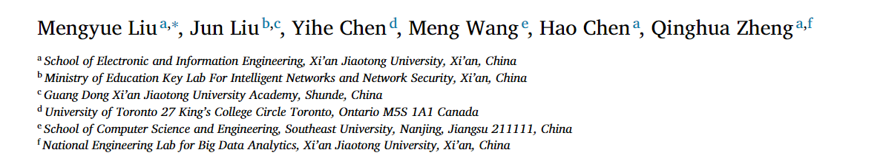
AHNG：Representation learning on attributed heterogeneous network
方子玄
2019/6/4

Slide 2
Introduction
Network embedding aims to encode nodes into a low-dimensional space with the structure and inherent properties of the networks preserved.
Most existing efforts are devoted to homogeneous networks.
However, networks in real-world scenarios are usually heterogeneous, i.e., they contain multi-type nodes/links and diverse node attributes.

Slide 3
Challenges
How to fuse heterogeneous information sources including network structures, semantic information and node attributes.
How to capture uncertainty of node embeddings caused by diverse attributes..

Slide 4
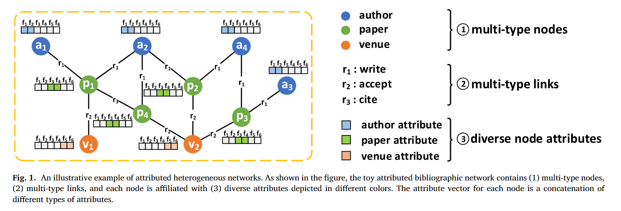

Slide 5


Few heterogeneous network embedding methods came out until the concept of meta-path is presented..
there are two kinds of meta-path be- tween a2 and a4 , indicating different semantic information:
a collaborative relationship between a2 and a4:
a2 and a4 may have common research interests:

Slide 6
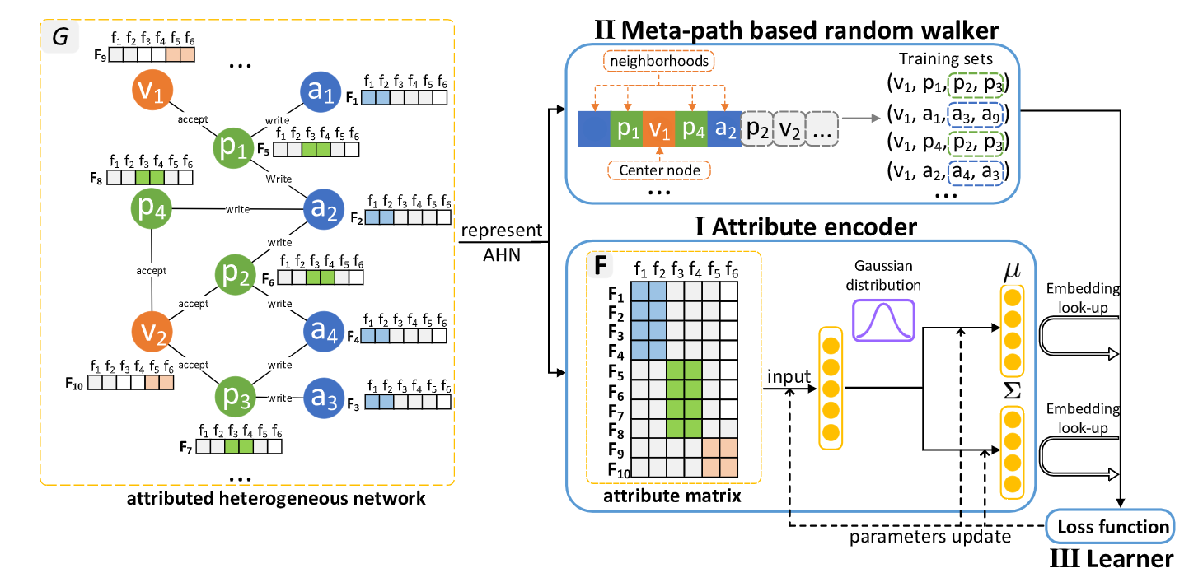
The proposed AHNG

Slide 7
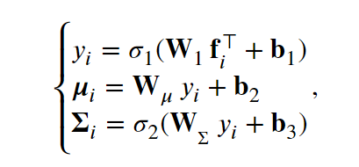
Attribute encoder
A two-layer neural network, called attribute encoder, processes the node’s attributes, outputs mean and covariance for each node:

Slide 8
Meta-path based random walker
Different from random walk-based models in homogeneous network, in which a random walker traverses the whole network without constraint, a meta-path based random walker traverse an AHN based on preassigned meta-paths.
As for those nodes who conform to con- ditions above, one of them is picked out randomly.

Slide 9


Learner
Skip-gram models maximize the probability of observing a neighborhood node (context) based on a center node embedding.
The key notion of skip-gram is to learn center node embeddings that specializes in predicting the nearby nodes, thus the similarity between a center node and a context node is assumed to be asymmetric. Hence, we use Kullback–Leibler(KL) divergence, a naturally asymmetric mea- sure, to incorporate covariance (denotes uncertainties of node representations) into the model:

Slide 10
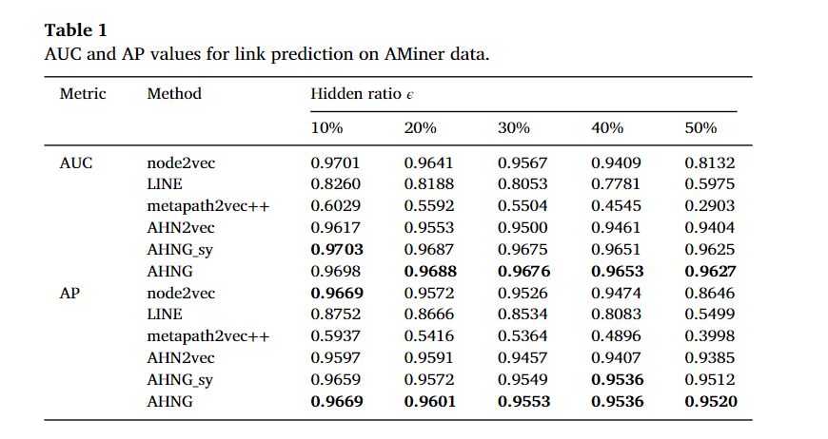
EXPERIMENTS

Slide 11
Thanks!

